Slide 1
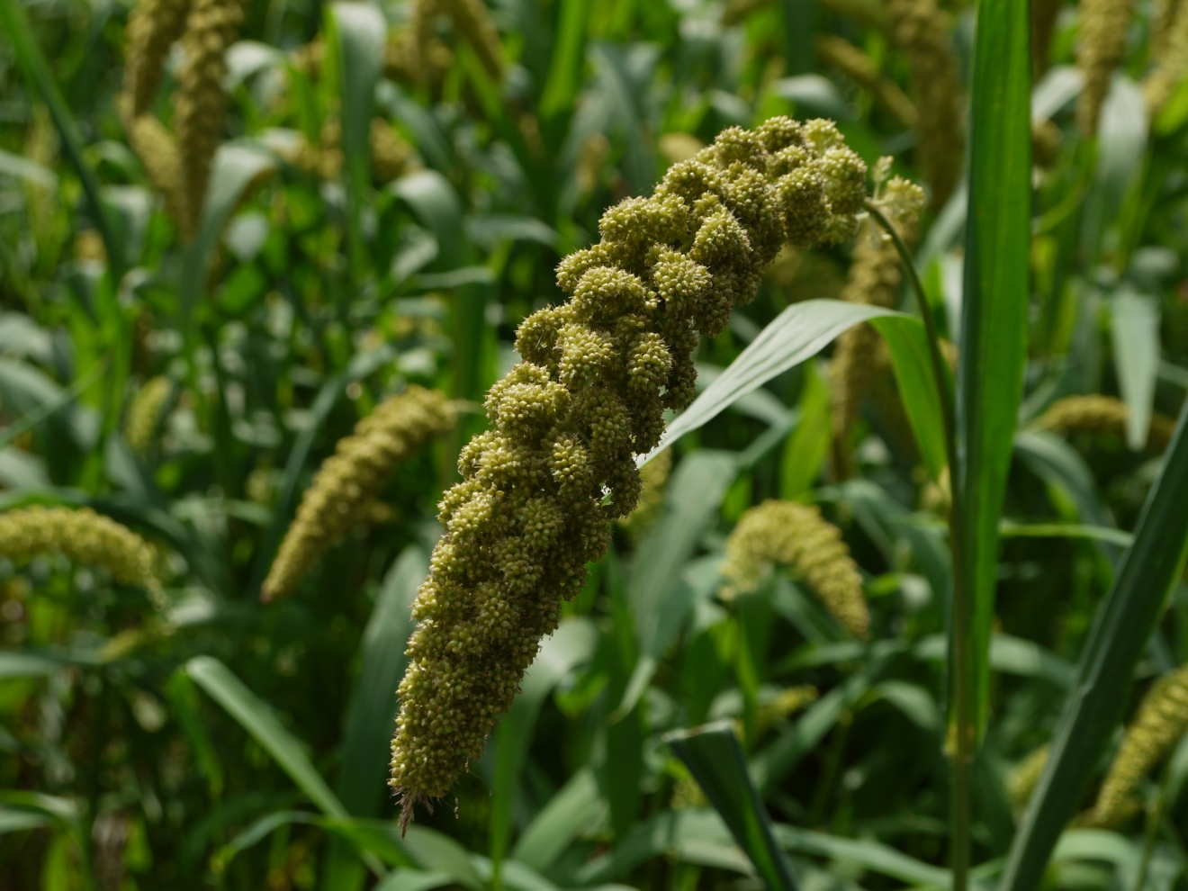

Who Controls Your Food?
Just observe these : Large Malls, Hypermarket, Your Buy & Save shops in neighborhood What you see as you enter ????
Heap of Rice packets
Heap of Wheat packets
Attractive Oil Cans / bottles
Sugar
Offers for combi packs consisting above all
How Come rice is available for Rs.1 per Kg while it takes Rs. 25 + for producing 1 kg of rice.?? Same is true for wheat. Who is forcing farmers to turn into Sugar cane farming ? Who has replaced our healthy Jagery with white sugar?

Slide 2
Who Controls Your Food? …
One big Multinational company wants you all eat rice+wheat+sugar diet all three time – that will keep them rich forever – these are Big Pharmacy Companies
Same Company supplies Seeds to farmer
Same company supplies pesticides and chemical spray
Same company has Cancer Cure Drugs
Has Multi specialty hospital chain
Are you aware about this ?
Just run their company and be profitable they are forcing a unhealthy food diet on you, You all working very hard day after day for what ? making them rich ?

Slide 3
What is the Solution ?
To Be healthy and happy is 100% in your Hand, and with technology and internet it has become ever easier
Energy thought-out the day
Free time for family and friends
Your money is making you rich not doctors / hospitals
Common cold, cough, fewer will never touch your kids
Ladies Special – wanna glow on your face – with no cosmetics
Do you want all these ?
Then
Follow on this presentation – you will have all these

Slide 4
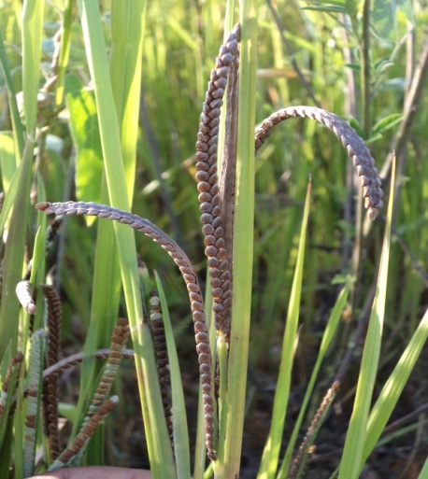

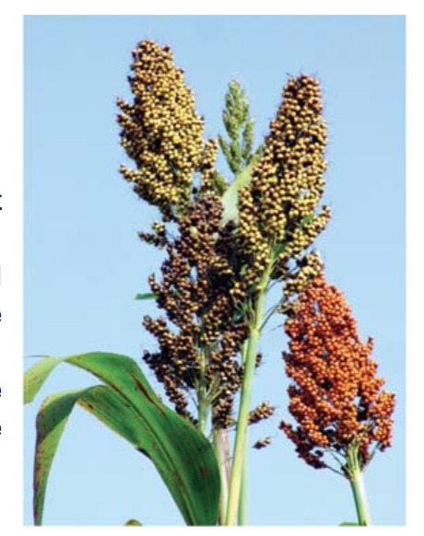
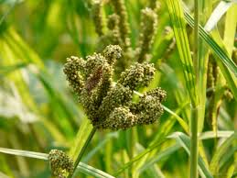
What are millets?
Millets are small-seeded grasses that are hardy and grow well in dry zones as rain-fed crops, under marginal conditions of soil fertility and moisture. Millets are one of the oldest foods known to humans and possibly the first cereal grain to be used for domestic purposes.

Slide 5
Why eat millets?
1. Nutrition:
a. Highly Nutritious, Non-Glutinous , Not acid forming
b. High in minerals like iron, magnesium, phosphorous and potassium
2. Environmental:
Millets Grow on rain fed and dry farm lands. They don’t require any chemical spray. Crop
cycle is less than 6 months.
Wheat, Rice and Sugar Cane Crops require 1000 + liters of water just to produce a Kg or two and all these were not at all there in our food system. For example Rice has history of just 350 years – earlier than this millets were our Staple food. Our healthy food system was broken down by Mutli-National pharma companies. Daily 3 times if you eat rice/chapati/white sugar you are sure to make hospitals+ pharma companies rich every year
Diabetic Market alone is 350 + billion $ and growing every year

Slide 6
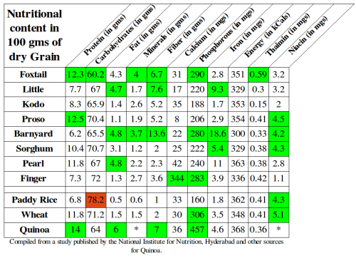
What is the Proof ?
Nutrient content in small millets compared to other common grains

Slide 7
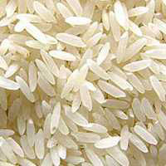
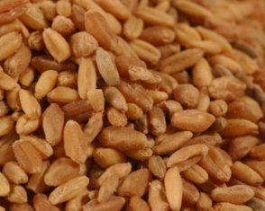
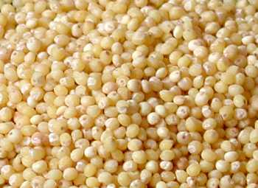


How to Know it is a Millet?
Millet is English name Given to our “Navadhanya” or “Siridhanya”
If the grain is small and round in shape that’s our food grain, elongated grains are not

Slide 8
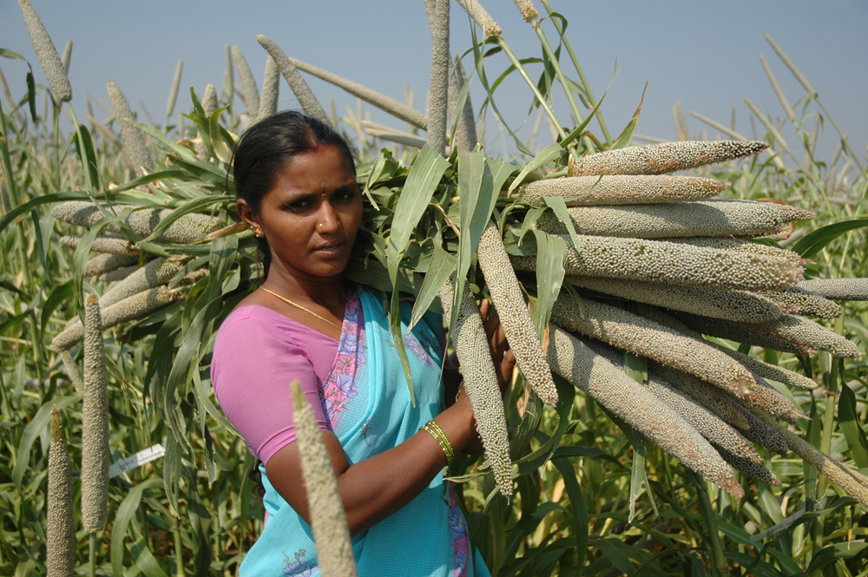
Millet - How it is Organic?
Millets are native to INDIA, they grow as grass !!! no pesticide or chemical spray to grow

Slide 9
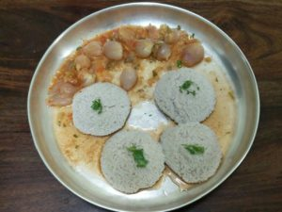
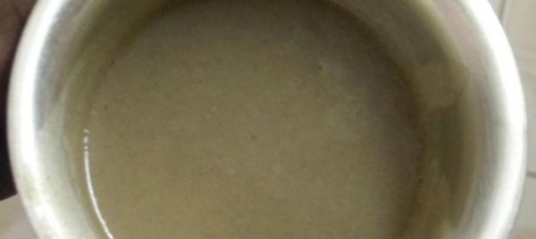
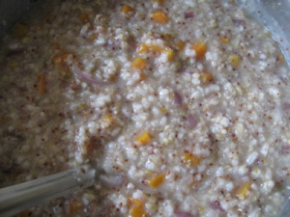
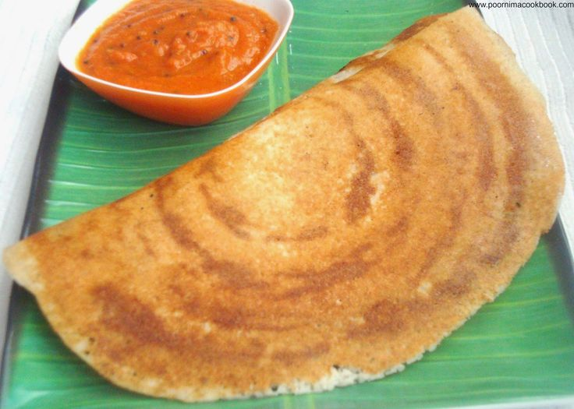
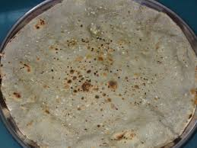
One Millet Meal a Day !!!!
All we are asking is One Millet Meal a day
Please Note : All your favorite dishes made from Rice and Wheat can be made from Millet Grains or Millet Atta

Slide 10
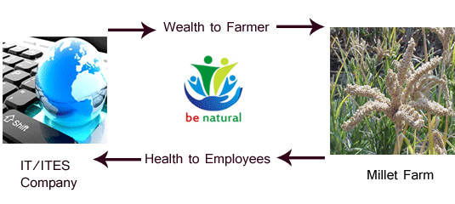
Impact of OMM a Day !!!!
Your Get :
Wealth
Save time, effort and money by saying goodbye to frequent hospital visit.
Diabetic is curable with this Millet Diet alone, if you don’t have you will never get it
It saves millions of liters of water every year – by stopping rice+wheat+sugar diet – your direct contribution to prevent global warming
Your one meal saves 100 of farmers all across INDIA. Many farmers have small and medium farm land and are rain dependant or are dry land – very good combination for Millets to grow !!!!
We promise you – you will attend your Grand daughter's /sons wedding - such is power of Millets

Slide 11
Reference
Many people have dedicated their whole life for this one cause
Reach good food for all
Dr. Vandana Shiva
http://www.navdanya.org/
Dr. Khadar
https://en.wikipedia.org/wiki/File:Dr.Khader,_Food_and_nutrient_expert,Mysore.jpg
Soil, soul and society:
By Satish Kumar
https://www.youtube.com/watch?v=uSLUd0veioU

Slide 12
Our Appeal
One can do many things to make a difference. But a group of people, a community can bring in change in no time.
Hence our appeal is :
let your one meal be a Millet Meal
This one decision will change life of our farming community – they will also live healthy and wealthy life
Thank you

Slide 13
Thank you
Thank you your Time & Consideration
Questions Please

